Slide 1
Quaternions, Part 2
Quaternion Connections to Social Robotics, Compassion, and Aesthetics
Herb Klitzner New York Academy of Sciences/Lyceum Society June 6, 2016
Link to presentationwww.klitzner.org/the-present klitzner@nyc.rr.com
©2016

Slide 2
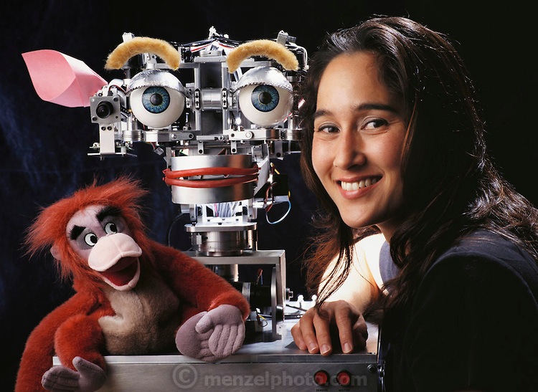
“Sociable Robots” Cynthia Breazeal with Kismet

Slide 3
Seeing the World as Processes, Not Things: Commonalities Between Coleridge (1815) and Kauffman (2014)
In this view, distinction, and process arising from distinction, is at the base of the world. Distinctions are elemental bits of awareness. The world is composed not of things but processes and observations. (Lou Kauffman, 2014)
The supposed atoms, he says, are mere abstractions of the mind; and Life is not a thing, the result of atomic arrangement or action, but is itself an act, or process. He refutes various definitions of Life, such as, that it is the sum of all the functions by which death is resisted; or, that it depends on the faculty of nutrition, or of anti-putrescence. His own definition he proposes merely as an hypothesis. Life, he says, is “the principle of Individuation,” that is to say, it is a power which discloses itself from within, combining many qualities into one individual thing. (Samuel Taylor Coleridge, c. 1815, as conveyed posthumously by editor Seth Watson, 1848)

Slide 4
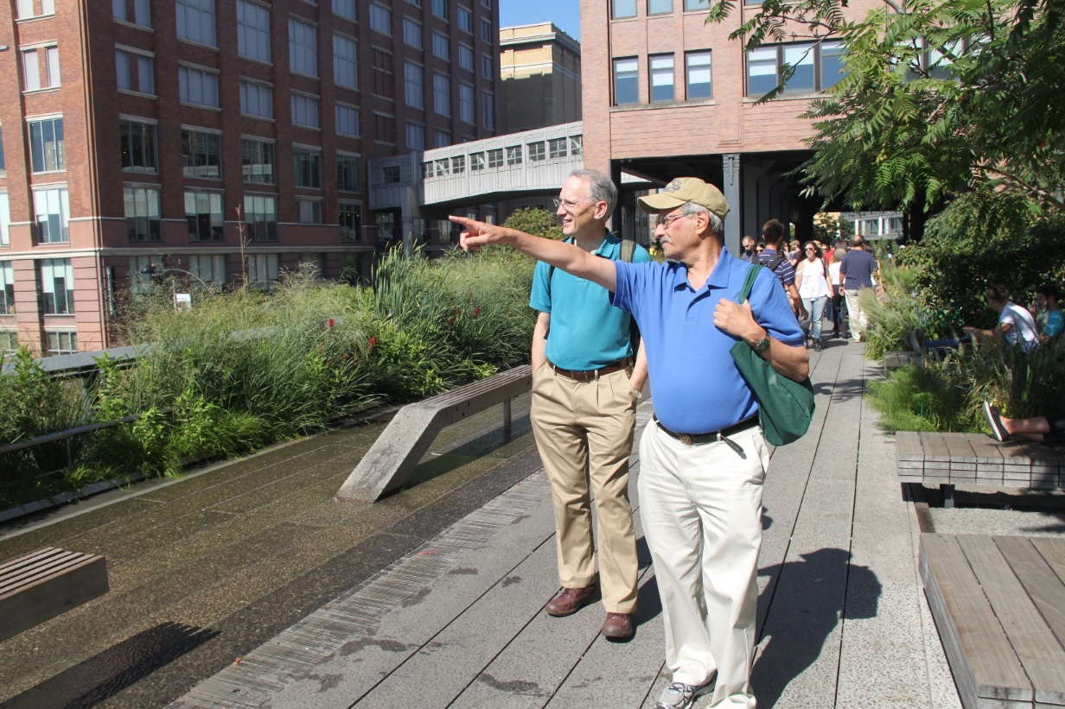
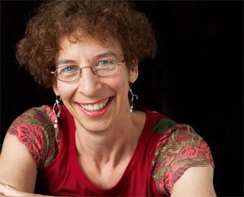
Preliminary Comments – New Publishing Collaborators: Hassen Fourati, Martin Hay, Terry Marks-Tarlow
Martin Herb
Hassen Terry

Slide 5
What We Published Together
Both Martin Hay and Hassen Fourati separately read my NYAS/Lyceum presentation on ResearchGate and got in touch with me. I also introduced Martin to Terry Mark-Tarlow and we quickly formed a research team to collaborate on quaternion research and article-writing.
Martin Hay (Prestbury, England), Terry and I published an article in the Newsletter of the Society for Chaos Theory in Psychology and the Life Sciences (October 2015).
Feature article title: “Quaternions, chirality, exchange interactions: A new tool for neuroscience?”
Terry Marks-Tarlow (Santa Monica, CA) is a “Jung-friendly” psychotherapist, researcher, and writer who uses conceptual math models based on fractals, quaternions, power series, etc., to interpret the nature of human learning and development .
Hassen Fourati (Grenoble, France) asked me to write a book chapter reviewing my talk:
It is the first chapter in the book: Recent Advances in Multisensor Attitude Estimation: Fundamental Concepts and Applications (to be published in June 2016).
Chapter title: “What are quaternions and why haven’t I heard of them?”

Slide 6
Contents
Overview
Short Review of my Lyceum Quaternion Lecture a Year Ago (June 2015)
Penny Spikins: Connection of Compassion to Aesthetics
Martin Hay and Terry Marks-Tarlow: Compassion and Quaternion Mathematics
Ada Lovelace: Aesthetics and Computers
Social Robotics and Artificial Intelligence
Conclusions

Slide 7
Overview
1843
2016
We show how the human mosaic of compassion and aesthetics is imbedded in pre-historic evolution, quaternions, and social robotics.
We emphasize the role of polarities as a common mechanism promoted by diverse thinkers for the past 200 years.
We draw on the disciplines of evolutionary anthropology/ archaeology; foundations of mathematics; and AI/computer science.

Slide 8
How My Theme Unfolded in My Mind
Cumulative areas of focus:
The attitudes of William Hamilton and Ada Lovelace toward aesthetics:
After I repeatedly read the comments of Hamilton and Lovelace (pioneering Victorian mathematicians), saying that their respective math inventions connected to poetics and aesthetics, I intuitively associated these subjects to today’s efforts to create sociable robots. These efforts are, perhaps, a renewed development of the interrupted concerns of Victorian Era math thinking.
Martin Hay and Chiral Quaternion Models – fairness and empathy for your social/financial counterpart’s viewpoint
Social Robotics research – search for empathy and expressivity (MIT, CMU)
Evolutionary Pre-History of compassion in both our very distant and more recent anthropological predecessors
Fundamental role of polarity and balance – Samuel Taylor Coleridge, Goethe, Hamilton, and Piaget – a convergence of understanding of poetic and scientific mechanisms

Slide 9
The Great Arc Connecting Two Eras (1843, 2016)
Victorian-Age Quaternion Thinking 1840-1900
Social Robotics Thinking 1995-2016
Spatial Social Intelligence
Aesthetics, Creativity,
Compassion, Empathy
Expressive-ness
Aesthetics and Polarities
3D Space Representation and Navigation
Music Cognition

Slide 10
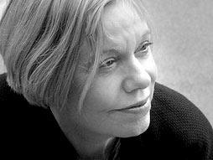
Definition of Compassion
Karen Armstrong (British writer on religious values) studied the values of many religions and found that essentially all of them taught compassion.
Karen gave compassion a two-part definition, in line with Aristotle’s definition of compassion.
PART 1 -- Identifying a Problem in another Person : Detecting a need, condition, or problem.
PART 2 -- Action To Fix the Problem: Going inward to find an ability or asset in oneself that would solve or reduce the problem, and then apply it to fix the need.
In contrast with empathy, compassion requires action; empathy is simply feeling “with” another person.

Slide 11
Klitzner’s “Compassion Question”
Problem: Can a social robot be designed to act “compassionately,” according to this definition, without possessing feelings? The answer seems to be “Yes.” The robot simply needs to carry out these two steps:
Identify a need in a person needing help.
Find a way to meet (or partially meet) that need with knowledge and resources at hand, and take action.
Current design goals for social robotics emphasize empathy, which is oriented toward feelings rather than actions. However, compassion might in the long run be a more appropriate and realizable goal for robotics to focus on, even though, in the short run, the appearance of empathy helps develop trust and engagement .
For humans, compassionate actions come from feelings. For robots, actions don’t require feelings, which in any case they don’t currently possess, and won’t for a very long time.

Slide 12
Quaternions, Polarities, Emotions
"A uniquely human feeling lies behind both the creation of such finely crafted tools and caring for the vulnerable. It suggests early humans, from two million years ago, were emotionally similar to us.“
Penny Spikins, from How Compassion Made Us Human
“Logic, geometry and matter have a deep common root, both cultural and invariant, inner and outer.”
Bernd Schmeikal, from his ResearchGate profile page
“There seems to me to be something analogous to polarized intensity in the pure imaginary part; and to unpolarized energy (indifferent to direction) in the real part of a quaternion: and thus we have some slight glimpse of a future Calculus of Polarities. “
William R. Hamilton, from a letter to John T. Graves (1844)

Slide 13
Victorian Mathematics and Poetry
“…Hamilton[‘s] quaternions… were, he writes in 1855, ‘born as a curious offspring of a quaternion of parents, say of geometry, algebra, metaphysics, and poetry.’ ” (p. 113)
Brown, Daniel. (2013). The Poetry of Victorian Scientists: Style, Sense, and Nonsense. Cambridge University Press
“Ada suggested that if musical tones and pitches and their key relations could be expressed in a scientific language of operation we might be able to produce musical pieces on a machine. She was uniting poetry and geometry by applying different laws, where 2 parallel lines could meet.”
Rehan Qayoom (2009), describing the aesthetic ideas of Ada Lovelace which she approached scientifically, c. 1840s, in relation to Charles Babbage’s design for digital computer.
From: The Complete Works of Rehan Qayoom (Volume I): Prose 1997-2008. Lulu.com (P. 38, discussion of quaternions and music)
Samuel Taylor Coleridge developed a philosophy of the commonality of polarity relations to both nature and poetry. He said that poems functioned as if they were living organisms in a 3D system.
“Water, water every where,
And all the boards did shrink;
Water, water every where,
Nor any drop to drink.“
The Rime of the Ancient Mariner

Slide 14
Goethe: Archetypes and Polarities
Goethe’s approach to scientific observation was to see the object of study from all possible points of view, and in all conditions, and then attempt to extract an Archetypal Idea that contained the essential attributes of that object.
“Goethe sought to understand the laws of transition from one organic form to another, not in the study of the parts alone, but by reaching out to apprehend the encompassing whole, the Archetypal Idea, which can but express itself in the ever-changing external phenomena through the interplay of contrasts and of polarities.” (Olive Whicher, 2013, Projective Geometry: Creative Polarities in Space and Time)
Quaternion tools lend themselves to operations in polarity situations such as presence/absence of a quality.

Slide 15
Coleridge and Hamilton
‘Hamilton was deeply interested in literature and metaphysics, and he wrote poetry throughout his life. While touring England in 1827, he visited William Wordsworth. A friendship was immediately established, and they corresponded often thereafter. Hamilton also admired the poetry and metaphysical writings of Samuel Taylor Coleridge, whom he visited in 1832 [and 1833]. Hamilton and Coleridge were both heavily influenced by the philosophical writings of Immanuel Kant.’ Wilkins, David (2016). Sir William Rowan Hamilton. Encyclopedia Britannica (Online)
‘In a word, Hamilton was one of the last Romantics who had preserved his ideals of the unity of poetry and science in a secret yet persistent way. Hamilton wrote that he had “always aimed to infuse into my scientific progress something of the spirit of poetry, and felt that such infusion is essential to intellectual perfection” (Graves, I, 354)… “I live by mathematics, but I am a poet.” (De Morgan, 132)‘
‘…Hamilton only met him on two occasions, yet Coleridge gave him philosophical inspiration ever after, as an oracular voice whose resonances were constantly heard.’
Ishikura, Waka (2008). Coleridge’s Poetic Ally―Sir William Rowan Hamilton. The Coleridge Bulletin: The Journal of the Friends of Coleridge New Series 32 (NS) Winter 2008.

Slide 16
Art Imitates Nature (or Human Environment)
Aristotle, John Dewey, Buckminster Fuller, Samuel Taylor Coleridge (philosophers who like this approach)
The Triangle:
Poetic Processes Extract Insights from Natural Models.
NATURE
POETRY STRUCTURAL PRINCIPLES

Slide 17
Coleridge on Nature, Poetry, and Polarity
The Nature of Poetry
Describing the poet: “…judgment ever awake and steady … while it blends and harmonizes the natural and the artificial, still subordinates art to nature.” (Coleridge, Biographia, Ch. 14)
‘Coleridge’s scientific language reconstructs poetry as a living organism, a three-dimensional object, which functions in much the same way as his plants, animals, and men in “Theory of Life.”’ (Corrigan, 2008, p. 144)
The Law of Polarity
“…contemplate in the phaenomena of electricity the operation of a law which reigns through all nature, the law of POLARITY, or the manifestation of one power by opposite forces … the second, namely, of the three primary principles [magnetism, electricity, and chemical affinity], for which the beautiful and most appropriate symbols are given by the mind in the three ideal dimensions of space.” (by Coleridge, c. 1816, revised Friend)
If magnetism demonstrated the law of polarity in inorganic matter, then electricity assimilated magnetism to reveal the one power that brings polarity to life in organic matter. (Corrigan, 2008, p. 148)
Timothy Corrigan (2008), Coleridge, Language, and Criticism. University of Georgia Press. From Chapter 4: “The Biographia Literaria and the Language of Science”, p. 121-152.

Slide 18
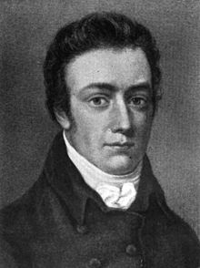
Coleridge on Nature, Poetry, and Polarity
‘…it is quite clear that the forces operative in a poem correlate directly with the three forces of nature: magnetism, electricity, and chemical affinity. There is, in other words, a six-part homology established between the world of biology and the world of poetry. The great value in transferring this three-part model from science to poetry is that Coleridge could use it to distinguish different operations in a poem while implicitly suggesting their unity on the evidence that, as in the biological example in “Theory of Life,” “the lower powers are assimilated, not merely employed—which presupposes homogeneity”’ (“Theory of Life,” p. 386).(Corrigan, 2008, p. 144)

Slide 19
Coleridge on Polarities and Life (as summarized by Seth Watson’s introduction to The Theory of Life)
“The prevalent natural philosophy of the present day is that which is called corpuscular, because it assumes the existence of a first matter, consisting of corpuscula or atoms…, which are supposed to be definite, though extremely small, quantities, invested with the qualities of extension, impenetrability, and the like; and from certain combinations of these qualities, Life is considered, by some persons, to be a necessary result.
“This philosophy Mr. Coleridge combats. The supposed atoms, he says, are mere abstractions of the mind; and Life is not a thing, the result of atomic arrangement or action, but is itself an act, or process.
“…The most general law governing the action of Life, as a tendency to individuation, is here designated polarity…
“Now this quality, to which Mr. Coleridge gives the name of polarity, is in truth nothing more than an exemplification of the doctrine of opposites, …which the Eleatic Philosopher, in Plato's “Sophist,” applies to the idea of existence and non-existence…”

Slide 20
Polarities and Balances Coleridge and Poetry
‘As Seth Watson observes in his introduction to “Theory of Life,” magnetism thus becomes the “first and simplest differential act of Nature … the first step from indifference to difference, from formless homogeneity to independent existence” (Theory of Life, p. 360).’
‘In a poem this rudimentary act of fixity and differentiation is described by the famous pairs that constitute all poems and that become objectified elements in the poem – “sameness with difference; of the general, with the concrete; the idea, with the image; the individual, with the representative; the sense of novelty and freshness, with old and familiar objects; a more than usual state of emotion, with more than usual order” (Biographia Literatia, Ch. 14).’
‘These poles differentiate a poem, define it, and balance it, as it were, in a fixed position. Balance, in fact, is the key to the polar arrangement in a poem, just as it is in a magnet, for “in all pure phaenomena we behold only the cupula, the balance or indifference in opposite energies.”
Coleridge as described and quoted by Corrigan, 2008, p. 145-146

Slide 21
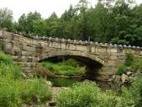
Polarities and Balances Marks-Tarlow and Psychological Development
Psychological birth is preceded by the paradoxical union of opposites within the unconscious, as we begin our mental life with good/bad, you/ me, inside/outside melded together. In order to make first distinctions, nascent consciousness must separate each pole from its opposite. Yet, complete psychological evolution requires that we bring together, blend and balance all opposites. Inner development requires that we leave ourselves in order to get deeper inside.
Terry Marks-Tarlow (2013), Fractal Geometry as a Bridge Between Realms

Slide 22
Robot Videos from MIT and Jibo, Inc. Interactive Social Robots
TOFU and TOFU Mini
“Squashable and Stretchable”; mobile
TOFU is a project to explore new ways of robotic social expression by leveraging techniques that have been used in 2d animation for decades. Disney Animation Studios pioneered animation tools such as “squash and stretch” and “secondary motion” in the 50’s. Such techniques have since been used widely by animators, but are not commonly used to design robots. https://vimeo.com/6409030?from=outro-embed (1:27), Tofu Mini
Mochi
Mobile https://vimeo.com/4197879 (1:02), Introducing Mochi
Jibo https://youtu.be/3N1Q8oFpX1Y (3:13), Jibo: The World’s First Robot for the Home.
Stationary but relocatable, 17 inches high with base, video screen face, 5 lbs. plus batteries
Personal data assistant (PDA), verbally directable picture taker, telepresence-driven video camera (i.e. controlled remotely from another site)
Note how interaction is encouraged by the robots in verbal and nonverbal ways.
Videos are viewable at the above sites, reflecting projects at the Personal Robotics Group, MIT, and at the robot manufacturer Jibo, Inc.

Slide 23
Cynthia Breazeal
Director of Personal Robots Group, Media Lab, MIT
She and her graduate students have made many varied robots in the last 10-15 years. Each has been an experiment.
“She works to produce empathic, highly expressive robots.”
“…personal robots that are socially intelligent, interact and communicate with people in human-centric terms, work with humans as peers, and learn from people as an apprentice.
“Her recent work investigates the impact of social robots on helping people of all ages to achieve personal goals that contribute to quality of life…
“Jibo is designed to help busy families to communicate, coordinate, and connect with loved ones with greater ease, efficacy, and delight.”
From Cynthia Breazeal’s faculty bio and from Jibo, Inc. literature.

Slide 24
Cynthia Breazeal –From Video Interview with Wall St. Journal (Geoffrey Fowler)
Jibo, the robot, is a relational social agent with a full character with utility, rather than an information agent that answers questions in the manner of the Siri voice system.
Success depends on staying within a chosen set of domains that can be controlled to produce dependable, useful results (meet expectations you set up).
Crowdfunding (2014, Indiegogo) goal was $100,000 -- response was $2.3 million raised!
“Family robot” organizing concept -- $600 FULL RETAIL PRICE (like smartphones)
Here are some built-in robot functions come with the basic product (others are downloadable): -- Recognize people; -- Take pictures and videos; -- Telepresence abilities (control from outside the house environment) -- Educate children and adults; -- Be an “open platform” to encourage 3rd-parties to develop apps.
https://www.youtube.com/watch?v=y0OsiWTAib0 (8:48) 1/8/15

Slide 25
Short Review of Quaternions, Part 1 (June 2015)
History
Applications
Definition and Theory
Brief Math Update Since June 2015 Presentation

Slide 26
History Overview – Quaternions vs Vectors
1880
Clifford, Gibbs, Heaviside
TIME CIRCLE
1840-2015
Expansion of Quaternions
The Grand Debate
Expansion of Vectors
Contraction of Quaternions
Recognition of Grassmann
Hamilton, Grassman
1910
1840
START
Minimal Activity with Quaternions
New Uses of Quaternions
2015
1985

Slide 27
Historical Overview – Contributors
Per-iod | Era | Personalities
1 | Mid-19th C. | Wm. Hamilton (1843), Robt. Graves (1843), Hermann Grassmann (1832, 1840, 1844), Olinde Rodrigues (1840) Ada Lovelace (1843)
2 | 2nd half 19th C. | Benjamin Peirce (1870), Charles Sanders Peirce (1882), Peter Tait (1867), Clerk Maxwell (1873), (Josiah) Willard Gibbs (1880-1884), Oliver Heaviside (1893), Wm. Clifford (1879), Felix Klein
3 | 1st Half 20th C. | Jean Piaget (1918), Wolfgang Pauli (1927), Paul Dirac (1930, 1931), E.T. Whittaker (1904, 1943), L. L. Whyte (1954), Nicolas Tesla, E.B. Wilson (1901)
4 | 2nd half 20th C. | David Hestenes (1966, 1987), Ken Shoemake (1985), Karl Pribram (1986), John Baez (2001), NASA, Ben Goertzel (2007), Jack Kuipers (1960s-1990s)
 | Historians of Math | Michael Crowe (1967), Daniel Cohen (2007), Simon Altmann (1986)
 | Philosophers and Educators of Math | Ronald Anderson (1992), Andrew Hanson (2006), Jack Kuipers (1999), Doug Sweetser (2014, www.quaternions.com )

Slide 28
Quaternion Applications
The list represents a great variety of tasks and interests requiring determining orientation, and performing rotating, filtering, smoothing, and control operations. Benefits include more accuracy and better performance than other techniques.
Social Robotics – Rotating of body components and facial features
Eye tracking
Virtual Reality
Real and mental rotation
Mathematical Physics problems (e.g. Maxwell equations, quantum physics)
Aerospace – space shuttle pilot software
Computer graphics, video games, smooth interpolation
DNA genomic analysis
Bio-logging (animal locomotion orientation)
Music composition
Intellectual development of logic
Imbedded schema augmentation in human development
Supergravity
Signal processing and filtering
Control Processing and Frame (of Reference) Control
Color Face Recognition
Quantum Physics (e.g. Dirac and Special Relativity – 2x2 Pauli Spin Matrices)

Slide 29
Brief Description of a Quaternion
So what is a quaternion? (Example: 3 + 7i + 2j + 10k)
This math relates algebra to 3D space geometry (using 4D tools). At its foundation are three imaginary numbers, each different!
A quaternion is an algebraic object with a “quantity” part and a “pointing or location” part.
These are called the scalar and the vector parts, so we write Q= S + V .
The S part is real and the V part is made of imaginary number components, i, j, k, -- all three are different: They each serve as different unit direction-pointers – in other words -- independent unit axes.
So the quaternion Q = S + V = w + (xi + yj +zk), where w, x, y, z are real number “multiplier” coefficients. “w” is the turning angle in radians. “(xi + yj +zk)” is the point that with the origin determines the axis line of rotation. The parameters are functionally transparent. This is not true of matrix expressions of rotation.
Any point (w,x,y,z) in any 4D real number space can be interpreted as a quaternion object, which in turn is interpretable as a rotation and sizing operator.
Quaternions were the first 4D math system in history.

Slide 30
Extended Math Neighborhood
Hierarchical list– each number system is an extension of the earlier system above it. The systems in the orange box are called normed division algebras, and have powerful features related to inverses:
Natural numbers
Integers
Rational numbers
Real numbers (1Dim, no imaginaries)
Complex numbers (2D, 1 imaginary number)
Quaternion numbers (4D, 3 imaginary numbers)
Octonion numbers (8D, 7 imaginary numbers)
Geometric Algebra*
Clifford Algebra systems
*Geometric algebra is a Clifford algebra of a finite-dim. vector space over the field of real numbers endowed with a quadratic form
Note: Hypercomplex numbers mean a number containing multiple different imaginaries.

Slide 31
Research Notes on Imaginary Number Process Models Since 1980
Iterant Algebra (imaginary number generator model)
Lou Kauffman (1987)
Kauffman, L. [1987], Imaginary values in mathematical logic. Proceedings of the Seventeenth International Conference on Multiple Valued Logic, May 26-28 (1987), Boston MA, IEEE Computer Society Press, 282-289.
Oscillatory number series process: i = +1, -1, +1, -1, +1, -1 … with very rapid oscillation (first instance of i) offset of 3 ticks: i = (start:) +1, -1, +1, -1, +1 … (second instance of i) i²= (+1)(-1) or (-1)(+1) = -1, so i is square root of -1
Also i, j, k (different imaginary numbers) are all different oscillators
Fractals – chiral tetrahedral quaternions may have a fractal aspect
Benoit Mandelbrot (early 1980s) – originator of fractals.
Generated patterns are based on different inclusion-set equations involving complex numbers or quaternions.
Martin Hays has found some evidence that chiral tetrahedral quaternions have a fractal structure in the properties of their tetrahedral “legs” (ligands). (Each unitary quaternion element has 4 ordered polarities, each of which can itself have 4 components).

Slide 32
Research Notes on Imaginary Number Process Models Since 1980 (Lou Kauffman)
Lou Kauffman (2014), Iterants, “Fermions and the Dirac Equation” – Excerpts
“The simplest discrete system corresponds directly to the square root of minus one, when the square root of minus one is seen as an oscillation between plus and minus one. This way thinking about the square root of minus one as an iterant is explained below. More generally, by starting with a discrete time series of positions, one has immediately a non-commutativity of observations since the measurement of velocity involves the tick of the clock and the measurement of position does not demand the tick of the clock….”
“In this view, distinction and process arising from distinction is at the base of the world. Distinctions are elemental bits of awareness. The world is composed not of things but processes and observations. We will discuss how basic Clifford algebra comes from very elementary processes like an alternation of +−+−+−· · · and the fact that one can think of √ −1 itself as a temporal iterant, a product of an ϵ and an η where the ϵ is the + − + − + − · · · and the η is a time shift operator. Clifford algebra is at the base of the world! And the fermions are composed of these things.”

Slide 33
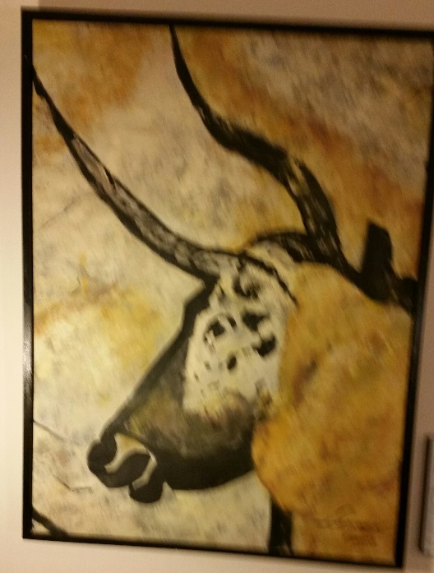
Penny Spikins: Connection of Compassion to Aesthetics
“Helen’s Bull” By Helen Craig Jennings – Based on the Lascaux Paleolithic cave paintings
Message: Perpetuation of the power of art across space and time

Slide 34
Social Communication and Aesthetic Power Penny Spikins on Neanderthal Use of Aesthetics in Aiding Migration
“Why is European Upper Palaeolithic art so immediate, so moving? I can’t help but wonder if the scale of human interconnections and independence in ice-age Europe provides an explanation. [By contrast] much art produced by hunter-gatherers is highly stylized, heavily symbolic, difficult to decipher to those living outside these contexts. Without the story behind the symbols in such art we don’t feel the same in response. Yet the art of the Upper Palaeolithic has some kind of universal appeal, a natural response we feel to the sensitivity of figurative depiction of lions hunting and deer swimming across a river.
“Might the power to transport of such art, a sense of being there, feeling the awe of feeling closeness to majestic animals, have been the way it is because it needed to cross different cultures? Travelling from the Rhineland to the coast, would people need art to convey their sensitivity, their trustworthiness to others, to cross ethnic boundaries?”
Penny Spikins (2015), How Compassion Made Us Human

Slide 35
Aesthetics and Evolutionary Neurobiology – C. U. Smith
“Aesthetics lies at the core of human mentality, and its study is consequently of importance not only to philosophers and art critics but also to neurobiologists.”
C. U. Smith (2005), Evolutionary Neurobiology and Aesthetics. (Affiliation: Vision Sciences, Aston University, U.K.)

Slide 36
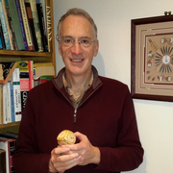
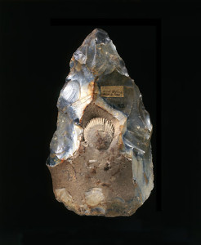
Compassion, Aesthetics, and Polarities Penny Spikins, Martin Hay

Slide 37
What We Can Learn From Evolutionary Archaeology: Caring, Compassion, Aesthetics, and Creativity
Caring, Compassion, and Aesthetics --
There is a historical continuity.
References:
Penny Spikins (2015), How Compassion Made Us Human
A. M. Rosenthal-von der Pütten et al (2014), Investigations on empathy toward humans and robots using psychophysiological measures and fMRI.
Spikins, Slocombe, Needham (Paper in Preparation), Self-compassion and material objects.
Caring
Compassion (for people and via robots)
Aesthetics:
(For Objects)
Images
Symbolic Works
Cave Paintings
Hand Implements
Sociable Robots

Slide 38
Penny Spikins: Compassion Predates Intelligence in Early Humans
News Report following publication of Spikins’ 2015 book on archaeology and compassion:
London Times: Early humans developed kindness, compassion and a sense of beauty long before the emergence of intelligence, a new study has claimed.
"Human evolution is usually depicted as driven by intelligence, with empathy and deeper emotions following," said Penny Spikins, who researches human origins at York University.
"However, the evidence suggests it happened the other way round. Evolution made us sociable, living in groups and looking after one another, even before we had language.
Our success since then, including the evolution of intelligence, all sprang from that," Spikins said. Spikins pointed to archeological finds hinting that even pre-humans had unsuspected emotional depths. Among the earliest is the Makapansgat pebble, a small rock with pits and markings resembling a baby's face, found in a South African cave with australopithecines, dating back 3 million years.
Deccan Chronicle, Feb 22, 2015

Slide 39
Penny Spikins: Evolutionary History of Compassion
Researcher based at University of York (U.K.), Centre for Human Palaeoecology and Evolutionary Origins. Research Interests:
the significance of care for the vulnerable in human origins; the evolution of social emotions.
Caring produced both compassion and aesthetics.
She reviews the archaeological record of humans and pre-humans from the earliest times to recent pre-history. (3 million years ago to 7,000 years ago).
Brain size starting in the period 1 to 3 million years ago grew in Homo ergaster from 1/3 of present size to 2/3. Penny attributes this to the effects of caring -- growth of cognitive solutions to compassion problems and the development of aesthetic-driven tools and art products.
“Speaking to the Sunday Times, she said three groups of early humans show behaviours relating to kindness and compassion, and that these behaviours developed long before early man started to show signs of intelligence and speech, which started as late as 150,000 years ago.”
Australopithicines -- 3 million years ago -- carried possible baby-image stones home several miles
Homo ergaster -- 1.5 million years ago -- cared for the sick
Homo heidelbergensis – 450,000 years ago – cared for a disabled person
“My recent research addresses the role of autism in prehistoric societies, the evolution of emotions and the maintenance of egalitarian hunter-gatherer communities.” (From book blurb for her 2010 book, The Prehistory of Compassion. http://www.blurb.com/user/PennySpikins)

Slide 40
Penny Spikins: Caring for the Sick and Disabled (Sunday Times, London)
“[At 1.5 million years ago,] … evidence suggests Homo ergaster cared for their sick, while Homo heidelbergensis, from 450,000 years ago, are believed to have nursed disabled children.
"[Evidence suggests] early humans' survival would have depend­ed on co-operation," she said. "Aggres­sive or selfish behaviour would have been very risky."
“Spikins published her findings in the book How Compassion Made Us Human [see link below]. She points to a 250,000-year-old axe that contained a fossilised scallop to decorate the tool – suggesting humans had developed a sense of aesthetics and beauty.”
"A uniquely human feeling lies behind both the creation of such finely crafted tools and caring for the vulnerable. It suggests early humans, from two million years ago, were emotionally similar to us."
‘Speaking about the subject of emotion among Neanderthals previously, Spikins said: "Compassion is perhaps the most fundamental human emotion. It binds us together and can inspire us but it is also fragile and elusive. This apparent fragility makes addressing the evidence for the development of compassion in our most ancient ancestors a unique challenge, yet the archaeological record has an important story to tell about the prehistory of compassion.’
"We have traditionally paid a lot of attention to how early humans thought about each other, but it may well be time to pay rather more attention to whether or not they 'cared'.“ (Sunday Times)
https://books.google.com/books?id=elzdCQAAQBAJ&pg=PT249&lpg=PT249&dq=social+robotics+compassionate&source=bl&ots=sepSYVtM-o&sig=X4bKUEfTvcZu77ZeGGFJfY4cACg&hl=en&sa=X&ved=0ahUKEwiLrtjfnqPJAhUI7CYKHVwNB_EQ6AEIOTAE#v=onepage&q=social%20robotics%20compassionate&f=false

Slide 41
Integrated Timeline for Technology, Compassion , Aesthetics
3 million years ago – rise of caring, in pre-human australopithecines*
1.5 million years ago - sensitivity, compassion in Homo ergaster communities - care for sick*
450,000 years ago -- Homo heidelbergensis – care for a disabled person*
250,000 years ago – symmetrical, fossil-jeweled hand-axe:*
Handaxe found at West Tofts in Norfolk (U.K.), made from a rock containing a fossilised scallop shell and designed to make the fossil the centrepiece of the tool.
150,000 ago or earlier – human language and intelligence*
70,000 years ago – Neanderthal care for the disabled*
20,000 – 17,000 years ago – Lascaux cave paintings, and other works
c. 1815 – S. T. Coleridge -- interest in polarities and balances as reflected in life and poetry – he described how the two domains resemble each other
c. 1843 (year in which quaternions were invented) – Hamilton and Lovelace – collectively, recognition of aesthetics potential and polarities representation in both quaternions and computer computation
1985-2016 – Martin Hay and his social application of his chiralkine model and later his chiral tetrahedral quaternion model, which draws on the chemical model of Capozziello & Lattanzi
1995-2016 – contemporary Social Robotics -- Cynthia Breazeal (MIT), Reid Simmons (CMU), etc.
*Descriptions based on Penny Spikins (2015), How Compassion Made Us Human

Slide 42
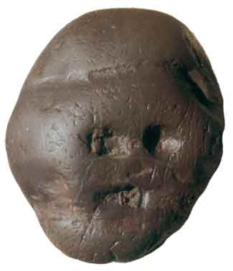
Ancient Examples from the Timeline (Cultural Objects and Images)
3 million years 250,000 years 20,000-17,000 years

Slide 43
Victorian Example from the Timeline
One of Ada Lovelace’s Processing Worksheets
Diagram for the Computation by the Engine of the Numbers of Bernoulli
Wikimedia Commons (public domain in the U.S.), 1842 document
(Her Bernoulli algorithm would have worked if the machine had been built.)

Slide 44
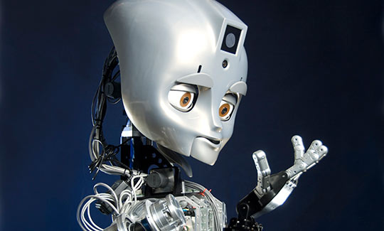
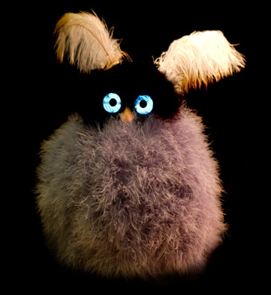
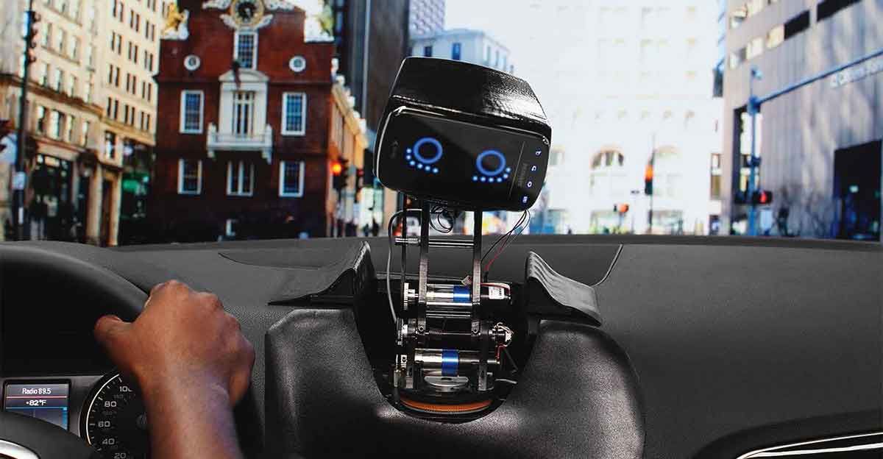
Contemporary Examples from the Timeline Maddox, Mochi, Tofu, Aida
Personal Robotics Group, MIT

Slide 45
Connection of Compassion Concepts to Unitary Quaternions and to Social Robotics
Compassion
Unitary Quaternions
Martin Hay: Social Exchange Model of Chiral Tetrahedral Quaternions
Social Robotics
Empathy
Expressivity
Sensitivity
Fairness and
Understanding Another Person’s Situation
Ultimately
Produce
Creativity

Slide 46
Compassion and Quaternion Mathematics
Contributions of Martin Hay and Terry Marks-Tarlow

Slide 47
Compassionate Mathematics -- A Social Insight by Martin Hay
Note: Martin Hay has developed social applications of quaternions and related chiralkine models for 30 years, in the fields of accounting, taxation, voting, and has extended his model to brain coordination of processes.
“Quaternions enable one to model
what is happening from both sides of a relationship.”
“Your message [about Penny Spikins and the prehistoric evolution of compassion] is timely in many ways. For me, it picks up what I have been trying to achieve through all this work on quaternions/ordered polarities/games etc. It is about a compassionate mathematics: a symbolic logic for empathy; a way of coding social information that is social [in use].”
Martin Hay (2015), email

Slide 48
Martin Hay: Social Exchange, Antisymmetric Relationships, Money, and Entanglement
“In real life, people’s interests are connected together even when they are competing with one another.
Many relationships between individuals are antisymmetric, for example creditor/debtor and landlord/tenant relationships. When such antisymmetric relationships are created, a single token is often used to denote them, and as a consequence the antisymmetric function represented by the token can over time become lost from view.
For example, money is created whenever two individuals agree that a token can represent a debt incurred in return for receipt of some goods or service. The money may go on to change hands many times, so that after a while, everybody has forgotten that the holder of the money is linked as creditor/debtor to the person that received the original goods or service.
Money starts to become viewed as functioning only on its holder’s behalf, just like tokens in known games. Unfortunately, when this happens, when everybody forgets that money has an invisible antisymmetric opposite (debt), it sets up conditions for a financial crash or destructive conflict.”
Quaternions enable one to model what is happening from both sides of a relationship.
Martin Hay (2015), email

Slide 49
An Identity-Development / ”Entanglement” Insight by Terry Marks-Tarlow
“… whereas [in the article “Fractal geometry as a bridge between realms”] I called fractals the semiotic sign of identity in nature, perhaps quaternions are the semiotic sign of observer/observed entanglement by which identity gets forged. This is easy for me to conceptualize from a developmental perspective, as the baby's sense of self gets slowly bootstrapped out of interaction with primary caregivers (the observing selves of others). Who is the observer and who is the observed continually shifts as baby watches mother watching baby (Trevarthan's primary intersubjectivity) until baby watches self through the eyes of mother.”
Terry Marks-Tarlow (2015), email

Slide 50
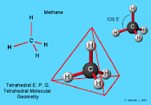
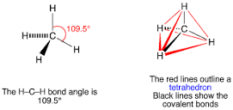
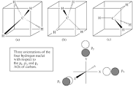
Tetrahedral Methane Explaining Chiral Tetrahedral Quaternions
http://chemwiki.ucdavis.edu/Core/Inorganic_Chemistry/Molecular_Geometry/Tetrahedral_Molecular_Geometry
http://www.chemtube3d.com/VSEPRShapeCH4.html
http://meta-synthesis.com/webbook/40_polyatomics/polyatomics.html

Slide 51
Dual Tetrahedra in a Cube Two Red Rods from the Center of a Tetrahedron Come Forward to the Diagonal Corners of the Front Face, and Two More Go To the Back Diagonal Corners; and Green Rods Come from the Second Tetrahedron Center, Two Forward and Two Back
1
2
4
3

Slide 52
Coding of the Quaternion Cube Based on the Elements (Ligands) of Two Chiral Tetrahedrons
Example of Cube Face Coding using the Corner Nodes:
1 2 3 4 (corner ligands, meaning bound objects, here hydrogen atoms)
….Using coding rules becomes four ordered polarities:
1 0 1 0 (1=1st tetrahedron; 0=2nd tetrahedron)
face coding
(corresponds to a quaternion value i or j or k etc.)
1 0 1 0
From Martin Hay coding diagrams

Slide 53
Martin Hay: Unitary Quaternion Coding – Quaternions and Life
“I think that this coding system is used by life: [1] in the brain to structure thought, and [2] in chemistry to code the chemistry of life.”
Martin Hay, email

Slide 54
Martin Hay: Unitary Quaternion Coding – Enzyme Analogy
“A unitary quaternion is a chiral tetrahedron. Four ordered polarities code the different ways in which a chiral tetrahedron can map to a hole (receptor), as for example in an enzyme.
“The six faces and eight corners of a cube are different docking presentations for a chiral tetrahedron acting as a ligand for a receptor (key and lock).”

Slide 55
Martin Hay: Unitary Quaternion Coding – Four Ordered Polarities
“There are sixteen ways of permuting four ordered polarities.
“As I found when inventing “chiralkine systems” and Bernd Schmeikal has independently found and expressed in very elegant mathematics is that a logic system can be constructed which has a ‘mother algebra’ composed of four polarity strings: (+ - + -), (+ - - +), (+ + - -) and (+ + + +). Each polarity string has a dual, which is its mirror image.
“The trick is to see that the strings (+ + + + ) and its opposite (- - - -) are as + and -. The other trick is to see that the order of the polarities in a string matters (1, 2, 3, 4). So, the whole system is coded in four ordered polarities….”

Slide 56
Polarities and Balances Convergence of Hay, Kauffman, Spencer-Brown, Coleridge
Martin Hay’s Unitary Quaternions model overlaps with S. T. Coleridge’s system of polarities and distinctions, which in turn resonates with Spencer-Brown’s 1969 mathematical system, the “calculus of indications.”
“…of G. Spencer-Brown and his calculus of indications. In this formalism we have a logical particle P that is its own anti-particle. Thus P interacts with itself to either produce itself or to cancel itself. Exactly such a formalism was devised by Spencer-Brown as a foundation for mathematics based on the concept of distinction.” Lou Kauffman (2014). Iterants, Fermions and the Dirac Equation (p. 2). Arxiv. Reference: G. Spencer–Brown (1969). Laws of Form. London: George Allen and Unwin Ltd.
“Thus we cannot escape the fact that the world we know is constructed in order to see itself. This is indeed amazing. Not so much in view of what it sees, although this may appear fantastic enough, but in respect of the fact that it can see at all. But in order to do so, evidently it must first cut itself up into a least one state which sees, and at least one other state which is seen.” (G. Spencer Brown, Laws of Form)
When a distinction is made, a polarity opens up (+1, -1 appear out of zero) and later close (resolve to net zero), representable as superposed, invisible polarities, and a new polarity or distinction opens up in its place:
“So, symmetry breaking creates a distinction (resolves “zero” into + and -), at the same time removing a distinction between “zero” and its opposite. Quaternion multiplication coded in four ordered polarities models this, and also models rotations in 3D space.” (Martin Hay, email)
This may be a biological/psychological process of consciousness and/or short-term memory, as suggested by the Necker Cube effect (discussed in our Quaternion Chirality paper).

Slide 57
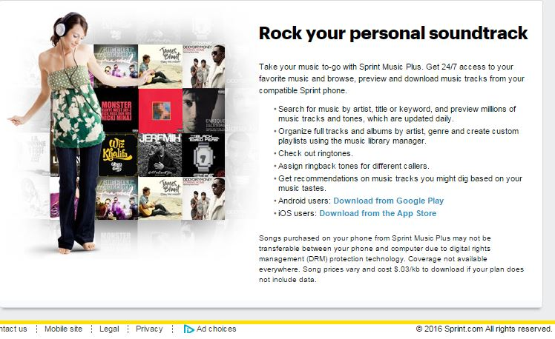
Ada Lovelace Aesthetics and Computers
1843 – Projections of Computer Music
“Supposing, for instance, that the fundamental relations of pitched sounds in the science of harmony and of musical composition were susceptible of such expression and adaptations, the engine might compose elaborate and scientific pieces of music of any degree of complexity or extent.” (Ada Lovelace, Wikipedia)
2016 – Smartphone music services
Sprint ad

Slide 58
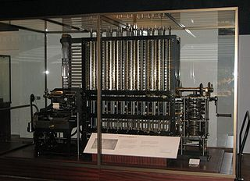
Difference Engine: Design: 1834-1871 Implementation: 1991

Slide 59
Computer Era Comparisons (1830s, 1940s)
The two eras:
1840s: Charles Babbage, The Analytical Engine and Difference Engine, 1834-1871 design:
The Difference Engine was built in 1991 by the London Science Museum. In 2008 Nathan Myhrvold financed a copy for the Computer History Museum in Mountain View, CA.
Mechanical programmable computer.
1940s: J. Mauchly & J. Eckert, ENIAC general-purpose computer, 1946-1955; its concept was later enhanced in another computer using John Von Neumann’s concept of a stored program, 1948. This design eventually led to the Univac I in 1952.
Electronic programmable computer – no moving parts (used the vacuum tube computer concept of Atasanoff, 1942)
Early computers in both eras were devoted to mathematical table construction. These computers automated existing human calculation algorithms.
Based on information in Wikipedia, ENIAC

Slide 60
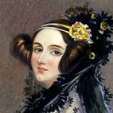
Ada Lovelace, Poetical Science, and Computer Programming
Full name: Augusta Ada Byron King, Countess of Lovelace
Ada described her approach as "poetical science"^{[6]} and herself as an "Analyst (& Metaphysician)".^{[7]} As a teenager [age 17], her mathematical talents led her to an ongoing working relationship and friendship with fellow British mathematician Charles Babbage, also known as 'the father of computers', and in particular, Babbage's work on the Analytical Engine. Between 1842 and 1843, she translated an article by Italian military engineer Luigi Menabrea on the engine, which she supplemented with an elaborate set of notes of her own, simply called Notes. [These notes were longer than Menabrea’s original text!]
These notes contain what many consider to be the first computer program—that is, an algorithm designed to be carried out by a machine. Lovelace's notes are important in the early history of computers. She also developed a vision of the capability of computers to go beyond mere calculating or number-crunching, while many others, including Babbage himself, focused only on those [numerical] capabilities.^{[8]} Her mind-set of "poetical science" led her to ask questions about the Analytical Engine (as shown in her notes) examining how individuals and society relate to technology as a collaborative tool.^{[5]}
^{from Wikipedia (Ada Lovelace)}
The thrust of social robotics design today is to create collaborative behavior between the human and the social robot.

Slide 61
Ada Lovelace Music and Non-Quantity Computation
“Lovelace speculated that the Engine 'might act upon other things besides number...” (Carvalhais, 2010)
1842 Quotation by Ada Lovelace
“Supposing, for instance, that the fundamental relations of pitched sounds in the science of harmony and of musical composition were susceptible of such expression and adaptations, the engine might compose elaborate and scientific pieces of music of any degree of complexity or extent.” (Ada Lovelace, Wikipedia)
“The idea of a machine that could manipulate symbols in accordance with rules and that number could represent entities other than quantity mark the fundamental transition from calculation to computation. Ada was the first to explicitly articulate this notion and in this she appears to have seen further than Babbage.”
José Carvalhais (2010), Towards a Model for Artificial Aesthetics

Slide 62
Social Robotics and Artificial Intelligence
Researchers
Terminology
Social Robotics Examples
Levels of Creativity in “Artificial” Intelligence

Slide 63
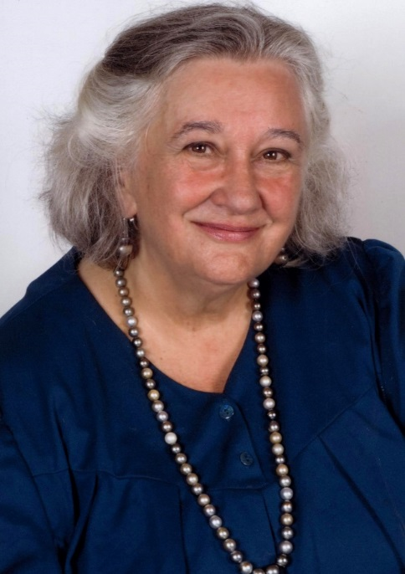
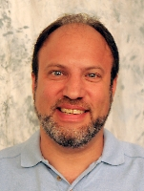
Key Researchers Connecting Pre-History, The Victorian Age, and Social Robotics Ada Lovelace, Margaret Boden, Peggy Spikins, Cynthia Breazeal, Reid Simmons, Naho Kitano

Slide 64
Emotional and Moral Themes
Some current issues in Social Robotics and Social Anthropology:
Aesthetics
Creativity
Expressivity
Sensitivity
Compassion
Fairness
Ethics

Slide 65
Social Robotics Terminology
Each robot type below is contained by the one above it.
Robot
Self-operated physical object or tool. Human-like, or not (such as a car factory robot arm). Mobile or immobile. Can have any purpose and capability – physical, informational, or social; smarter or more limited and mechanical.
Social Robot
Has some kind of sensitivity to people and has a communicative, expressive “attitude”; has the ability to negotiate/navigate in some specific social situations; able to provide a comfort level to most humans; in summary, has some social knowledge and manner.
Sociable Robot
Proactive design to be socially successful – able to act as a companion and social agent, and form bonds of expectation, interest, and even trust. Caring behavior at some level. This recapitulates at least some aspects of our own evolutionary experience with each other millions of years ago.

Slide 66
Quaternions and Expressive Interactive Movements in Social Robotics
Abstract
“A real-time motion engine for interactive synthetic characters, either virtual or physical, needs to allow expressivity and interactivity of motion in order to maintain the illusion of life.
Canned animation examples from an animator or motion capture device are expressive, but not very interactive, often leading to repetition.
Conversely, numerical procedural techniques such as Inverse Kinematics (IK) tend to be very interactive, but often appear "robotic" and require parameter tweaking by hand.
We argue for the use of hybrid example-based learning techniques to incorporate expert knowledge of character motion in the form of animations into an interactive procedural engine.”
Blumberg, Michael M., and Johnson, Michael Patrick (2003). MIT affiliation.
Exploiting Quaternions to Support Expressive Interactive Character Motion.

Slide 67
Cynthia Breazeal – Jibo, Inc.
Market Information:
Sales to homes, mid-2016
Several million dollars invested by Charles River
Slogan is “A robot for every home”
Part of the R&D of her robots was funded by “crowdfunding”
“Jibo, Inc. manufactures and sells electronic robots. The company’s electronic robot lets users talk to Jibo; learns users’ preferences; helps users to make everyday tasks simpler and easier; communicates and expresses using natural social and emotive cues; reminds users’ of important tasks and events; and recognizes users and member of their household.”
“It offers solutions for adults, seniors, kids, teens, and developers….” (Bloomberg News)

Slide 68
Reid Simmons/CMU Social Robot Project
“The goal here is to make robots more useful and acceptable by enabling them to interact with humans using social rules and conventions.
This includes such rules as how to pass people in hallways in a socially acceptable manner, ride in elevators, and how to enter and wait in line.
In conjunction with members of the Drama department, we are starting a project to give a robot a personality, and have it converse with people. The goal is to develop a robot that can escort visitors around Newell-Simon Hall and provide useful information naturally and pleasantly.”
Reid Simmons, an oral history conducted in 2010 by Peter Asaro with Selma Šabanovic, Indiana University, Bloomington Indiana, for Indiana University and the IEEE.
http://ethw.org/Oral-History:Reid_Simmons#Human-Robot_Interaction

Slide 69
Human Wearable Coaching Robots
(Angel) Gabriel– Wearable Cognitive Assistant (Carnegie Mellon /Robotics Institute)
‘The researchers will be focusing on the fundamental technologies necessary to make wearable cognitive assistants, such as further improvements in computer vision and the incorporation of audio and location sensing. The initial applications will be for tasks that require specialized knowledge or skills, but ultimately cognitive assistance could be applied to virtually all facets of everyday life.
“Ten years ago, people thought of this as science fiction,” said Mahadev Satyanarayanan, professor of computer science and the principal investigator for Gabriel. “But now it’s on the verge of reality.”
In addition to Satyanarayanan, the research team includes Martial Hebert, director of the CMU Robotics Institute and an expert on computer vision…
In just the past year, Satyanarayanan and his colleagues have built proof-of-concept implementations that guide the assembly of LEGO models, teach freehand sketching and coach a neophyte Ping-Pong player.
“The experience is much like a driver using a GPS navigation system,” Satyanarayanan said. “It gives you instructions when you need them, corrects you when you make a mistake and, most of the time, shuts up so it doesn’t bug you.”
In many respects, it’s like a robot in its use of sensing and task planning; the big difference is that the actuation is performed by a person instead of a machine.’
“Computer System Will Be an Angel on Your Shoulder, Whispering Advice, Instruction.” (2015). CMU/RI news
http://www.ri.cmu.edu/news_view.html?news_id=437&fcode=2&menu_id=384

Slide 70
Naho Kitano and Shinto-Influenced Japanese Perceptions of Robots
Naho Kitano is a social researcher and the CEO of a robot manufacturing company, Hibot.
She says that people in Japanese society view robots positively, without fear, because their cultural bedrock of Shinto religious outlook teaches them that significant objects have souls. People therefore tend to extend a sense of caring toward these objects.
The Human Robot, a one-hour video about social robots and experimental self-replica robots, features interviews with Naho Kitano, Daniel Dennett, and other commentators and experimenters. The Human Robot (2015). https://www.youtube.com/watch?v=sXz0boNmwak
Rob van Hattum, vpro/backlight

Slide 71
“Artificial” Intelligence is a Part of Reality and We Are Connected To It
AI and aesthetics are connected.
Aesthetic AI products are indirectly human products, like paintings are.
Aesthetic creativity (when eventually achieved to a degree) will produce real, not artificial, art.
AI and compassion are connected.
Caring is the common link – what we care about, what rich objects move us – this goes back to the Paleolithic cave paintings and much earlier.
One can have elementary knowledge and caring without even having human-level intelligence.

Slide 72
José Carvalhais: AI & Artificial Creativity
We discuss highlights from the dissertation of José Carvalhais (2010, University of Porto, Portugal)
Title -- Towards a Model for Artificial Aesthetics: Contributions to the Study of Creative Practices in Procedural and Computational Systems
He presents a discussion of the “Lovelace Questions” by Margaret Boden, (see picture) which follow.
The catalyst for the questions is a cautionary statement by Lovelace, quoted by Carvalhais:
“Lovelace was convinced that the Analytical Engine was in principle able to “compose elaborate and scientific pieces of music of any degree of complexity or extent.”
“She however declared that the Analytical Engine had no pretensions to originate anything and that it could do only “whatever we know how to order it to perform”.

Slide 73
Carvalhais: The Lovelace-Questions
“It is not clear whether Lovelace merely intended to point [out] that a computer’s actions are strictly dependent on its input and programmed code — an important remark on itself and especially at the time — or whether these words were intended as an argument denying any possibility for artificial creativity, in a precedent to the ‘intelligence in the past’ argument and Halpern’s position.”
“According to Boden (2004, 16), the first person to publish this argument was Augusta Ada King, Countess of Lovelace, commonly known as Ada Byron or as Lady Lovelace.
“Very often then, the idea that computers can create is regarded as being intrinsically absurd: computers can only do whatever they were programmed to do and in doing so they produce results that are inevitably determinist, therefore they cannot create” (Boden 2004, 16).
“Much in the same way that cartesian dualism proposes a split between non-physical mental phenomena and the material body that is ‘animated’ by them, there is a generalized tendency to view machine intelligence or creativity as always being inherited from the human creator.”

Slide 74
Carvalhais: The Lovelace-Questions
“The simplicity of the argument, if indeed this is an argument against artificial creativity, leads Boden to present four distinct questions, that are often confused with each other, and to which she calls the ‘Lovelace-questions’, because they address the possibility of artificial creativity and because many people would probably answer them with a dismissive ‘No!’ by using Lady Lovelace’s argument.”

Slide 75
Carvalhais: The Lovelace-Questions
The first Lovelace-question is whether computational ideas can help us understand how human creativity is possible.
The second is whether computers (now or in the future) could ever do things which at least appear to be creative.
The third is whether a computer could ever appear to recognize creativity — in poems written by human poets, for instance.
And the fourth is whether computers themselves could ever really be creative (as opposed to merely producing apparently creative performance whose originality is wholly due to the human programmer).

Slide 76
Carvalhais: The Lovelace-Questions
Boden then proceeds to try to answer the four questions. Her answers to the first two questions are positive, for reasons we have also already discussed.
Boden’s answer to the third question is not so simple, as the question implies that in order to appreciate originality one needs at least some of the abilities that are required for creativity itself.
Being creative requires a capacity for critical evaluation so it would seem that question three could only be answered after question four, but considering that the question does not concern “the practicality of computer-criticism, but its possibility in principle”, Boden also replies positively.

Slide 77
Carvalhais: David Cope
Cope contends that computer programs can indeed create, defending the hypothesis that those who do not believe this may have probably defined creativity so narrowly that eventually even humans could not be said to create (2005, vii-viii).

Slide 78
Conclusions
Summary
Our Pre-Historic Compassion/Aesthetics Legacy Is Informing Our Approach To Social Robotics
We will learn to appreciate social robotic sensitivity, creativity/resourcefulness, and intelligence for its own sake, as different from us but arousing of our own humanity.

Slide 79
Conclusion: A Theme of Care, Continuity, and Legacy
We embed our values into our tools and culture, including caring and compassion toward others -- and through significant inanimate objects.
This statement is consistent with the conclusions of archaeology researcher Penny Spikins, University of York, England, and also Naho Kitano of Japan, who is a social researcher and CEO of the robot company, Hibot.
The sociable robotics movement can be viewed as an appropriate contemporary societal extension of the evolutionary caring history that Penny Spikins, with evidence, argues took place at the bedrock of pre-human life.

